Slide 1
Chapter 2 Data Query Language
Oracle 12c Database

Slide 2
Oracle Server Architecture
An Oracle database is a set of files on disk.
Access to the database is through the Oracle instance.
The instance is a set of processes and memory structures: it exists on the CPU(s) and in the memory of the server node, and this existence is temporary.
An instance can be started and stopped.
Users of the database establish sessions against the instance, and the instance then manages all access to the database.
It is absolutely impossible in the Oracle environment for any user to have direct contact with the database.
An Oracle instance with an Oracle database makes up an Oracle server.

Slide 3
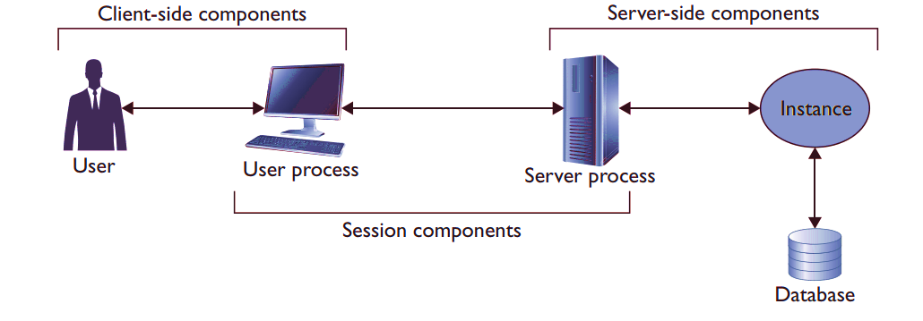
Oracle Server Architecture

Slide 4
Performing Single Table SELECT Statements
A QUERY is a request for information from the database tables and Queries do not modify data; they read data from database tables and views.
The basis of a query is the SELECT statement.
The SELECT statement can be used to get data from a single table or from multiple tables.
The SELECT statement is the most commonly used statement in SQL.
It allows you to retrieve information already stored in the database. The statement begins with the keyword SELECT, followed by the names of the columns with data you want to query.
You can select information either from all the columns (denoted by *) or from name-specific columns in the SELECT clause to retrieve data.
The rows returned by the database are known as a result set.

Slide 5
Capabilities of SQL SELECT Statements
Projection
Selection
A SELECT statement retrieves information from the database. With a SELECT statement, you can use the following capabilities:
Projection: Select the columns in a table that are returned by a query. Example Select as few or as many of the columns as required.
Selection: Select the rows in a table that are returned by a query. Various criteria can be used to restrict the rows that are retrieved.
Joining: Bring together data that is stored in different tables by specifying the link between them.
Table 1
Table 1
Join
Table 1
Table 2

Slide 6
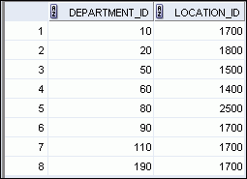
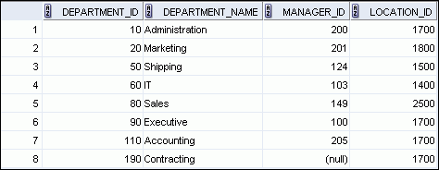
SELECT Columns Syntax
SELECT *|{[DISTINCT] column|expression [alias],...}
FROM table;
  SELECT identifies the columns to be displayed.
  FROM identifies the table containing those columns.
  Selecting All Columns
SELECT department_id, location_id
FROM departments;
SELECT * FROM departments;

Slide 7
Database Terminology
A keyword refers to an individual SQL element.
For example, SELECT ,FROM, WHERE are keywords.
A clause is a part of a SQL statement.
  For example, SELECT employee_id, last_name, and so on is a clause.
A statement is a combination of two or more clauses.
For example, SELECT * FROM employees is a SQL statement.

Slide 8
Writing Rules Of SQL Statements
SQL statements are not case-sensitive.
SQL statements can be entered on one or more lines.
Keywords cannot be abbreviated or split across lines.
Clauses are usually placed on separate lines.
Indents are used to enhance readability.
In SQL Developer, SQL statements can optionally be terminated by a semicolon (;). Semicolons are required when you execute multiple SQL statements.
In SQL*Plus, you are required to end each SQL statement with a semicolon (;).

Slide 9
Column Heading Defaults
  SQL Developer:
    Default heading alignment: Left-aligned
    Default heading display: Uppercase
  SQL*Plus:
    Character and Date column headings are left-aligned.
    Number column headings are right-aligned.
    Default heading display: Uppercase

Slide 10
Filtering the Rows that Are Selected
SELECT *|{[DISTINCT] column|expression [alias],…}
FROM table
[WHERE condition(s)];
The square brackets indicate that the WHERE clause is optional.
A condition is specified by comparing two terms using a conditional operator.
These terms may be column values, literals, or expressions.
The equality operator is most commonly used to restrict result sets.

Slide 11

Filtering the Rows that Are Selected
Restrict the rows that are returned by using the WHERE clause:
The WHERE clause extends the SELECT statement by providing the language to restrict rows returned based on one or more conditions.
The WHERE clause follows the FROM clause.
SELECT *|{[DISTINCT] column|expression [alias],...}
FROM table
[WHERE condition(s)];
SELECT employee_id, last_name, job_id, department_id
FROM employees
WHERE department_id = 90 ;

Slide 12
Character Strings and Dates Rows
Character strings and date values are enclosed with single quotation marks.
Character values are case-sensitive and date values are format-sensitive.
The default date display format is DD-MON-YY.
SELECT last_name, job_id, department_id
FROM employees
WHERE last_name = 'Whalen' ;
SELECT last_name
FROM employees
WHERE hire_date = '17-FEB-96' ;

Slide 13
Character Strings and Dates Rows
Character strings and date values are enclosed with single quotation marks.
Character values are case-sensitive and date values are format-sensitive.
The default date display format is DD-MON-YY.
SELECT last_name, job_id, department_id
FROM employees
WHERE last_name = 'Whalen' ;
SELECT last_name
FROM employees
WHERE hire_date = '17-FEB-96' ;

Slide 14
Using the ORDER BY Clause
Sort retrieved rows with the ORDER BY clause:
  ASC: Ascending order, default
  DESC: Descending order
The ORDER BY clause comes last in the SELECT statement:
SELECT last_name, job_id, department_id, hire_date
FROM employees
ORDER BY hire_date ;
SELECT last_name, job_id, department_id, hire_date
FROM employees
ORDER BY hire_date DESC ;
1
SELECT employee_id, last_name, salary*12 annsal
FROM employees
ORDER BY annsal ;
2

Slide 15
Using the ORDER BY Clause
  Sorting by using the column’s numeric position:
  Sorting by multiple columns:
SELECT last_name, job_id, department_id, hire_date
FROM employees
ORDER BY 3;
3
SELECT last_name, department_id, salary
FROM employees
ORDER BY department_id, salary DESC;
4
SELECT Employee_id, last_name, salary, commission_pct
FROM employees
ORDER BY commission_pct ASC NULLS LAST/FIRST, last_name DESC;

Slide 16
Limiting Rows Returned
The Fetch clause is used in conjunction with the select and order by clauses to limit the rows and retrieve a portion of the returning rows. Use the OFFSET and FETCH clauses to limit the number of rows retrieved by specifying a certain number of rows or certain percent of rows to be retrieved.
The WHERE clause and FETCH clause are used to restrict the amount of rows returned in the query.
WHERE is used for filtering the rows;
FETCH is used for limiting the rows.
The OFFSET is used to skip a specified number of rows before the retrieval begins.
[OFFSET rows_skip ROW[S]]
FETCH [FIRST/NEXT] [row_count | Percent PERCENT] ROW[S] [ONLY} | WITH TIES];

Slide 17
FETCH Rows Returned
The following examples clarify the use of the row-limiting clauses in SELECT.
First, show the top five salary-earned employees:
SELECT first_name, department_id, salary
FROM employees
ORDER BY salary DESC
FETCH FIRST 5 ROWS ONLY;
If there is a tie in the last row, using the WITH TIES clause instead of the ONLY clause will retrieve all rows with ties. The ONLY or WITH TIES keyword must always be used with the FETCH clause.
SELECT first_name, department_id, salary
FROM employees
ORDER BY salary DESC
FETCH FIRST 5 ROWS WITH TIES;

Slide 18
OFFSET Rows Returned
The OFFSET clause is used to skip rows before the limiting begins.
The following example shows the third through fifth position in salary:
SELECT first_name, department_id, salary
FROM employees
ORDER BY salary DESC
OFFSET 2 ROWS
FETCH NEXT 5 ROWS WITH TIES;

Slide 19
Using PERCENT
Instead of number of rows, you may limit using a PERCENT. The ONLY or WITH TIES keyword is a must whether using ROWS or PERCENT in the FETCH clause.
The following example shows using PERCENT to retrieve 5 percent rows
from the EMPLOYEES table:
SELECT first_name, department_id, salary
FROM employees
ORDER BY salary DESC
FETCH FIRST 5 percent ROWS ONLY;

Slide 20
Pseudo columns.
Each row in an Oracle database has a unique row identifier, or rowid, which is used internally by the Oracle database to store the physical location of the row.
A rowid is a unique identifier that contains the physical address of the row and its 18-digit number that is represented as a base-64 number that oracle generates automatically when row is inserted and its fastest way to access row is using ROWID and its permanent to every row and does not change the rowid.
You can view the rowid for rows in a table by retrieving the ROWID column in a query.
When you describe a table using the SQL*Plus DESCRIBE command, ROWID doesn’t appear in the output from the command because it is only used internally by the database.
ROWID is known as a pseudo column.
The following example describes the Employee table;
notice ROWID doesn’t appear in the output:
SELECT ROWID, Emp_id FROM emp;

Slide 21
Pseudo columns.
Another pseudo column is ROWNUM which is nothing but its consecutive logical sequence number which is given to the rows fetched from the table and is used to limit rows returned from the table.
However rownum is temporary and if you change the rownum will refer another row.
You can think rownum values like the row number in a excel spreadsheet.
The first row returned by a query has a row number of 1, the second has a row number of 2, and so on.
SELECT ROWNUM, emp_id, first_name, last_name
FROM EMP;

Slide 22
Defining a Null Value
If a row lacks a data value for a particular column, that value is said to be null or to contain a null.
Null is a value that is unavailable, unassigned, unknown, or inapplicable.
A null value is not a blank string—it is a distinct value.
Null is not the same as zero or a blank space.
Zero is a number and blank space is a character.

Slide 23



Defining a Null Value
Columns of any data type can contain nulls. However, some constraints (NOT NULL and PRIMARY KEY) prevent nulls from being used in the column.
SELECT last_name, job_id, salary, commission_pct
FROM employees;
…
…

Slide 24


Null In Arithmetic's
If any column value in an arithmetic expression is null, the result is null.
For example, if you attempt to perform division by zero, you get an error. However, if you divide a number by null, the result is a null or unknown.
In the example in the slide, employee King does not get any commission. Because the COMMISSION_PCT column in the arithmetic expression is null, the result is null.
SELECT last_name, 12*salary*commission_pct
FROM employees;
…

Slide 25
Defining Column Alias
The column alias name is defined next to the column name with a space or by using the keyword AS.
If you want a space in the column alias name, you must enclose it in double quotation marks.
Note that the optional AS keyword has been used before the column alias name.
The result of the query is the same whether the AS keyword is used or not.
A column alias is used :
  Renames a column heading
  Is useful with calculations
  Immediately follows the column name (There can also be the optional AS keyword between the column name and alias.) Requires double quotation marks if it contains spaces or special characters, or if it is case-sensitive

Slide 26


Defining Column Alias
SELECT last_name AS name, commission_pct comm
FROM employees;
…
SELECT last_name "Name" , salary*12 "Annual Salary"
FROM employees;
…

Slide 27
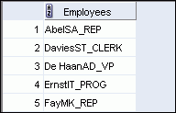
Combining Column Output Using Concatenation
You can combine the column values retrieved by a query using concatenation, which allows you to create more friendly and meaningful output.
A concatenation operator:
  Links columns or character strings to other columns
  Is represented by two vertical bars (||)
  Creates a resultant column that is a character expression
SELECT last_name||job_id AS "Employees"
FROM employees;

Slide 28
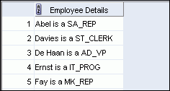
Literal Character Strings
A literal is a character, a number, or a date that is included in the SELECT statement.
Date and character literal values must be enclosed within single quotation marks.
Each character string is output once for each row returned.
SELECT last_name ||' is a '||job_id
AS "Employee Details"
FROM employees;

Slide 29
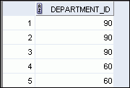
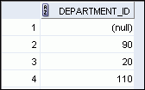
Displaying Unique Rows
The default display of queries is all rows, including duplicate rows.
SELECT department_id
FROM employees;
1
…
SELECT DISTINCT department_id
FROM employees;
2
…

Slide 30
Operators
Oracle allows you to perform different Operators in SQL statements such as:
Arithmetic Operators
Comparison Operators
Logical Operators

Slide 31
Arithmetic Operators
Create expressions with number and date data by using arithmetic operators.
Operator
Description
  +
Add
  -
Subtract
*
Multiply
  /
Divide
NOTE:
You can use arithmetic operators in any clause of a SQL statement (except the FROM clause).
DATE and TIMESTAMP data types can only be used addition and subtraction.
Oracle server IGNORES blank spaces before and after the Arithmetic operators.

Slide 32
Arithmetic Precedence
The normal rules of arithmetic operator precedence apply in SQL: multiplication and division are performed first, followed by addition and subtraction. If operators of the same precedence are used, they are performed from left to right.
For example, in the expression 10*12/3–1, the first calculation would be 10 multiplied by 12, yielding a result of 120; then 120 would be divided by 3, yielding 40; finally, 1 would be subtracted from 40, yielding 39:
You can also use parentheses () to specify the order of execution for the operators, as in the following:
SELECT 10 * (12 / 3 – 1) FROM dual;
In this example, the parentheses are used to force calculation of 12/3-1 first, the result of which is then multiplied by 10, yielding 30 as the final answer.

Slide 33


Arithmetic Operators
SELECT last_name, salary, salary + 300
FROM employees;
SELECT last_name, salary, 12*salary+100
FROM employees;
1
…
SELECT last_name, salary, 12*(salary+100)
FROM employees;
2
…

Slide 34
Comparison Operators
The EQUALITY operator is used extensively to illustrate the concept of restricting rows using a WHERE clause.
There are several alternative operators that may also be used.
The INEQUALITY operators like “less than” or “greater than or equal to” may be used to return rows conforming to inequality conditions.

Slide 35
Comparison Operators
Operator
Meaning
SELECT last_name, salary
FROM employees
WHERE salary <= 3000 ;
  =
Equal to
  >
Greater than
>=
Greater than or equal to
SELECT last_name, salary
FROM employees
WHERE salary BETWEEN 2500 AND 3500 ;
  <
Less than
  <=
Less than or equal to
  <>
Not equal to
BETWEEN
...AND...
Between two values (inclusive)
Lower limit
Upper limit
IN(set)
Match any of a list of values
SELECT employee_id, last_name, salary
FROM employees
WHERE manager_id IN (100, 101, 201) ;
LIKE
Match a character pattern
IS NULL
Is a null value

Slide 36
Comparison Operators
The BETWEEN operator facilitates range-based comparison to test whether a column value lies between two values.
The IN operator tests set membership, so a row is returned if the column value tested in the condition is a member of a set of literals.
The pattern matching comparison operator LIKE is extremely powerful, allowing components of character column data to be matched to literals conforming to a specific pattern.
The last comparison operator discussed in this section is the IS NULL operator, which returns rows where the column value contains a null value.
These operators may be used in any combination in the WHERE clause.

Slide 37
Like Operators
Use the LIKE operator to perform wildcard searches of valid search string values.
Search conditions can contain either literal characters or numbers:
  % denotes zero or many characters.
  _ denotes one character.
SELECT first_name
FROM employees
WHERE first_name LIKE 'S%' ;

Slide 38
Combining Wildcard Characters
You can use the ESCAPE identifier to search for the actual % and _ symbols.
The ESCAPE identifier instructs the Oracle server to treat any character found after the backslash character as a regular nonspecial symbol with no wildcard meaning.
SELECT first_name
FROM employees
WHERE first_name LIKE ‘SA\_%' ESCAPE ‘\’;

Slide 39

Using the NULL Conditions
The NULL conditions include the IS NULL condition and the IS NOT NULL condition.
The IS NULL condition tests for nulls.
A null value means that the value is unavailable, unassigned, unknown, or inapplicable.
Therefore, you cannot test with =, because a null cannot be equal or unequal to any value.
The slide example retrieves the last names and managers of all employees who do not have a manager. Here is another example: To display the last name, job ID, and commission for all employees who are not entitled to receive a commission,
use the following SQL statement:
SELECT last_name, manager_id
FROM employees
WHERE manager_id IS NULL ;

Slide 40
Logical Operators
A logical condition combines the result of two component conditions to produce a single result based on those conditions or it inverts the result of a single condition. A row is returned only if the overall result of the condition is true.
Three logical operators are available in SQL:
Operator
Meaning
  AND
Returns TRUE if both component conditions are true
  OR
Returns TRUE if either component condition is true
NOT
Returns TRUE if the condition is false

Slide 41

AND, OR Operators
AND requires both the component conditions to be true:
SELECT employee_id, last_name, job_id, salary
FROM employees
WHERE salary >= 10000
AND job_id LIKE '%MAN%' ;
OR requires either component condition to be true:
SELECT employee_id, last_name, job_id, salary
FROM employees
WHERE salary >= 10000
OR job_id LIKE '%MAN%' ;

Slide 42
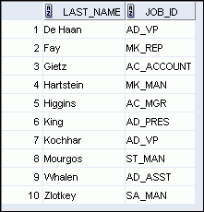
NOT Operator
SELECT last_name, job_id
FROM employees
WHERE job_id
NOT IN ('IT_PROG', 'ST_CLERK', 'SA_REP') ;
Note: The NOT operator can also be used with other SQL operators, such as BETWEEN, LIKE, and NULL.
  ... WHERE job_id NOT IN ('AC_ACCOUNT', 'AD_VP')
  ... WHERE salary NOT BETWEEN 10000 AND 15000
  ... WHERE last_name NOT LIKE '%A%'
  ... WHERE commission_pct IS NOT NULL

Slide 43
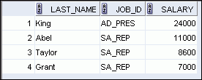

Order Precedence
Operator
Meaning
SELECT last_name, job_id, salary
FROM employees
WHERE job_id = 'SA_REP'
OR job_id = 'AD_PRES'
AND salary > 15000;
  1
Arithmetic operators
1
  2
Concatenation operator
  3
Comparison conditions
  4
IS [NOT] NULL, LIKE, [NOT] IN
  5
[NOT] BETWEEN
  6
Not equal to
  7
NOT logical condition
SELECT last_name, job_id, salary
FROM employees
WHERE (job_id = 'SA_REP'
OR job_id = 'AD_PRES')
AND salary > 15000;
  8
AND logical condition
2
  9
OR logical condition
You can use parentheses to override rules of precedence.

Slide 44
Using Substitution Variables
You can create variables that may be used in place of actual values in SQL statements.
These variables are known as Substitution variables because they are used as substitutes for values.
When you run an SQL statement, you enter values for the variables; the values are then “substituted” into the SQL statement.
There are two types of substitution variables:
Temporary variables A temporary variable is valid only for the SQL statement in which it is used—it doesn’t persist.
Pre / Defined variables A defined variable persists until you explicitly remove it, redefine it, or exit SQL*Plus.

Slide 45
Using Substitution Variables
Use substitution variables to:
  Temporarily store values with single-ampersand (&) and double-ampersand (&&) substitution
Use substitution variables to supplement the following:
  WHERE conditions
  ORDER BY clauses
  Column expressions
  Table names
  Entire SELECT statements

Slide 46
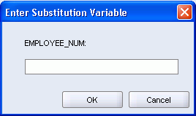
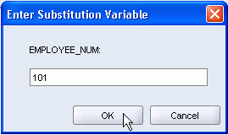

Using Substitution Variables
Use a variable prefixed with an ampersand (&) to prompt the user for a value:
SELECT employee_id, last_name, salary, department_id
FROM employees
WHERE employee_id = &employee_num ;

Slide 47
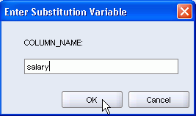
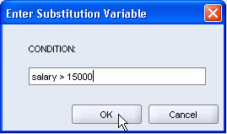
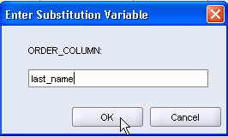
Specifying Column Names, Expressions, and Text
SELECT employee_id, last_name, job_id,&column_name
FROM employees
WHERE &condition
ORDER BY &order_column ;

Slide 48
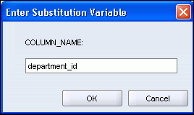

Using the Double-Ampersand Substitution Variable
Use double ampersand (&&) if you want to reuse the variable value without prompting the user each time:
SELECT employee_id, last_name, job_id, &&column_name
FROM employees
ORDER BY &column_name ;
…

Slide 49
Using the DEFINE command
Use the DEFINE command to create and assign a value to a variable.
Use the UNDEFINE command to remove a variable.
DEFINE employee_num = 200
SELECT employee_id, last_name, salary, department_id
FROM employees
WHERE employee_id = &employee_num ;
UNDEFINE employee_num

Slide 50
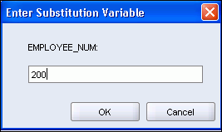
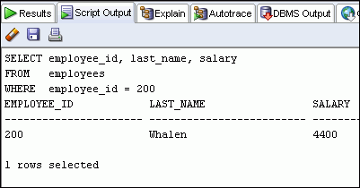
Using the VERIFY Command
Use the VERIFY command to toggle the display of the substitution variable, both before and after SQL Developer replaces substitution variables with values:
SET VERIFY ON
SELECT employee_id, last_name, salary
FROM employees
WHERE employee_id = &employee_num;

Slide 51
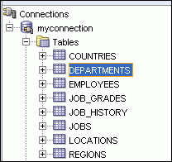
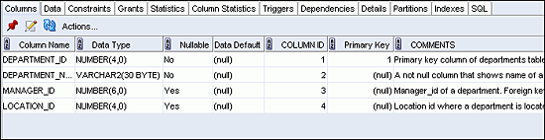
Displaying the Table Structure
  Use the DESCRIBE command to display the structure of a table.
  Or, select the table in the Connections tree and use the Columns tab to view the table structure.
DESC[RIBE] tablename

Slide 52
THANK YOU

